Slide 1
Actions in QTP – The Basics
By Anish Pillai
Automation Repository @ http://www.automationrepository.com

Slide 2
What you would read in this PPT:
What are QTP Actions.
What are the different types of QTP actions.
How actions access data from QTP data tables.
How to call actions in your QTP scripts.

Slide 3
What is a QTP Action?
QTP Action is a placeholder or a component in which you can write your scripts or code.
You can write your code in QTP actions in the same way you do in a function library or scripted business component.
Just like functions, actions also help to divide your test script into logical units or business flows.
In fact, a QTP test script is itself a collection of one or more actions.
Whenever you create a new test case, an action will also be created automatically for that test case.

Slide 4
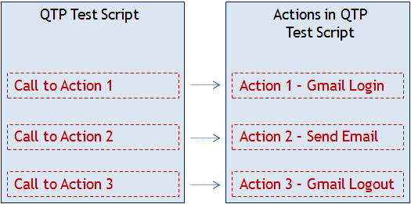
What is a QTP Action – contd..
Each test case in QTP consists of one or more actions and the flow of the test case is determined by the order of action calls.
Example: Consider a scenario where you
login to gmail >> send an email >> logout from gmail
This scenario can be scripted by adding 3 actions in a QTP test script as –

Slide 5
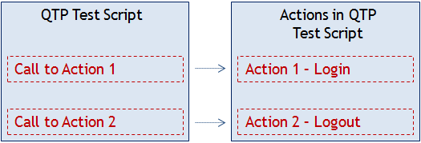
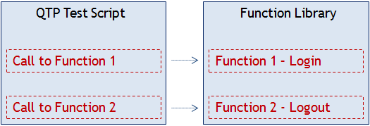
What is a QTP Action – contd..
Modularization provided by actions is similar to what is there with functions. Only difference is the implementation.
.. is similar to ..

Slide 6
Different Types of QTP Actions
QTP actions can be classified into the following different types -
Different Types of QTP Actions
Classification based upon reusability
Reusable Action
Non Reusable Action
Classification based upon where the actions are stored
External Action
Internal Action
NOTE: QTP documentation doesn’t specify an action type as ‘Internal’. We have just extended the ‘External Action’ type to come up with ‘Internal Action’.

Slide 7
Different Types of QTP Actions – contd..
QTP actions can be classified into the following different types -
Different Types of
QTP Actions
Reusable Actions : These are the actions that can be called multiple times by –
- the same test in which it is stored, and
- by other external tests also.
Non-Reusable Actions : These are the actions that can be called only once and that too in the test where they are stored.
These can’t be called from external tests.
Internal Actions : With reference to a QTP test case, an internal action is one that is stored within that test case.
This action can be reusable as well as non-reusable.
External Actions : With reference to a QTP test case, an external action is one that is stored in some other test case.
External actions should be reusable otherwise it can’t be used outside the test case.

Slide 8
QTP Actions and Data Sheets
QTP provides 2 types of inbuilt data sheets which can be used to store test data.
QTP Actions can interact with these data sheets using inbuilt QTP functions to -
read data from the data sheets, and
to write data to the data sheets.
Types of QTP Data Sheets
Global Data Sheet
Local Data Sheet

Slide 9
QTP Actions and Data Sheets – contd..
Global Data Sheets
A Global Data sheet is one which can be accessed by all the actions in the test case.
Local Data Sheets
A local Data Sheet is one which can be accessed by only one action.
Each test case has only one Global Sheet.
The name of the Global Data Sheet is ‘Global’.
This sheet can be used when you want to pass data between multiple actions.
The number of local sheets is equal to the number of actions in the test case. [Each action will have its own data sheet]
The name of the local sheet is same as the name of its associated action.
Local data sheet can be used to store data that would be used within that action only.

Slide 10
Calling Actions in your Test Scripts
Once you have a set of actions (internal or external) available with you, you can call these actions in your test scripts.
The order in which you call your actions defines the flow of your test case.
Example: login to Gmail >> send an Email >> logout from Gmail
There are two ways in which you can call actions in a test script -
2 ways to call actions in a test script
calling copy of an action
calling an existing action

Slide 11
Calling Actions in your Test Scripts – contd..
Call to Copy of an Action
When you call the copy of an action into a test case, the original action is copied in its entirety.
You can call copies of actions when you want to use the same action with some modifications.
Call to Existing Action
When you call an existing action, the action would be called as a read-only action.
You can call existing actions where you want to reuse the same actions without any modifications.
If you make any changes to the copied action, it will not affect the original action in any way.
The action can only be modified in the test in which it is created. This will affect all the tests where it is called.

Slide 12
THANK YOU
We are always eager to know what you think about our content. For feedback, suggestions or any queries, please email us at anish@automationrepository.com
For more QTP Tutorials, visit –
www.automationrepository.com
www.automationrepository.com/tutorials-for-qtp-beginners/

